Slide 1


F-Kiddy FINAL DEMO
Ozlem CINAR
Elif Berfin BASAN

Slide 2
What Is F-Kiddy?
It is an IOS application where parents can find their child when they lost their child.

Slide 3
Why do we need F-Kiddy?
Lost children are one of the biggest fears of parents.
Lost children constructs 34% of total lost people.
F-Kiddy’s goal → decrease this percentage.

Slide 4

What we did?
Back-End
Local Database
Front-End
Design phase
Face Recognition related screens
Connection Between Back-End and Front-End
Web Service
Testing

Slide 5
Hardware
Smart Phone
System Camera(SmartPhone Camera)
Local Computer

Slide 6
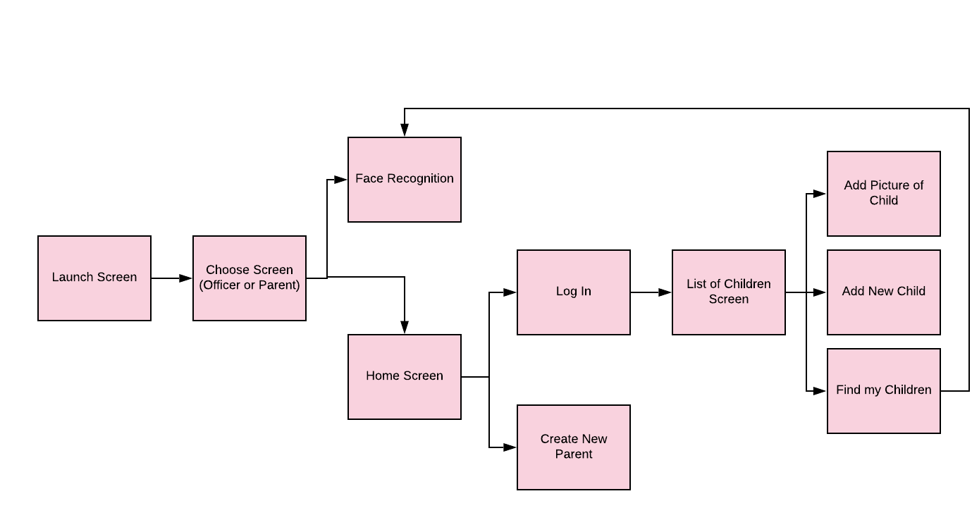
How Project Works?

Slide 7


Slide 8
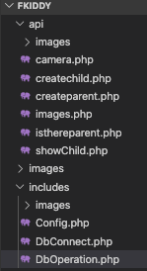
Back-End Progress
Php in Visual Studio Code
MySQL in PhpMyAdmin
Web Server in MAMP

Slide 9
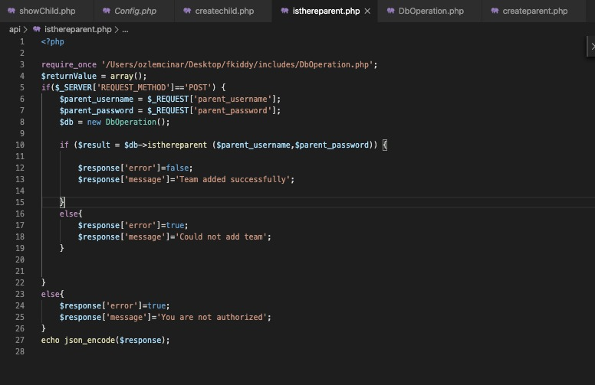

Slide 10
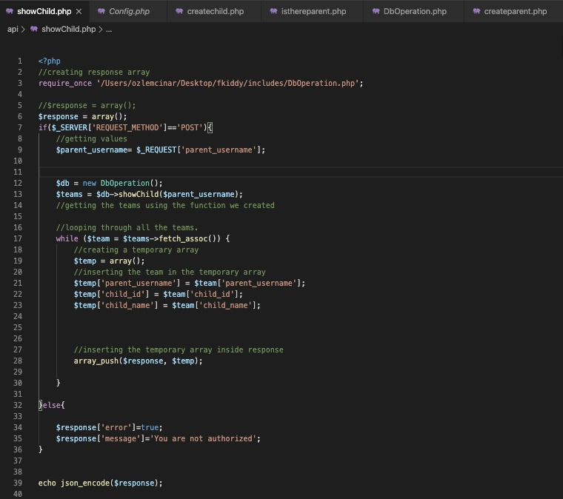

Slide 11
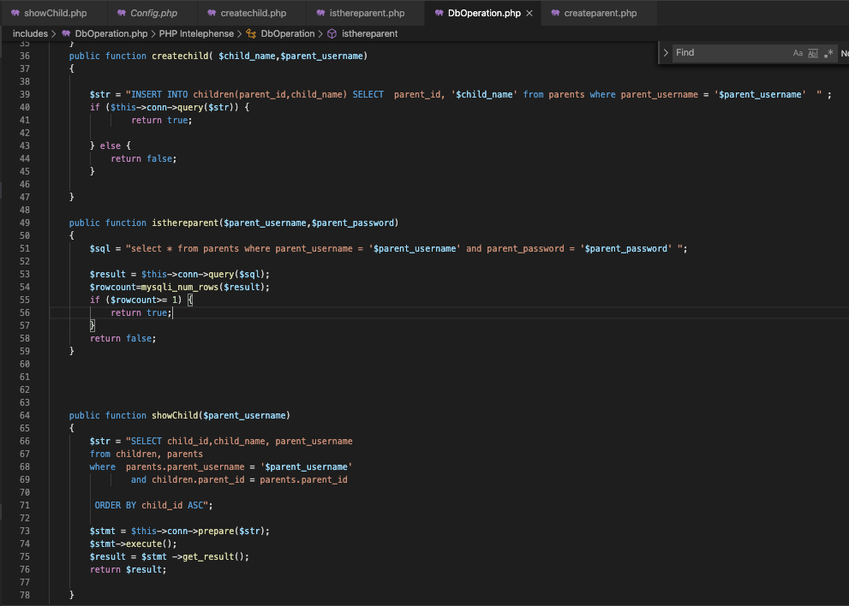

Slide 12
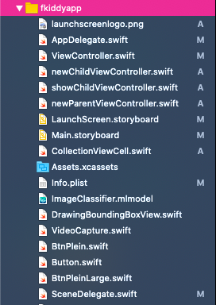
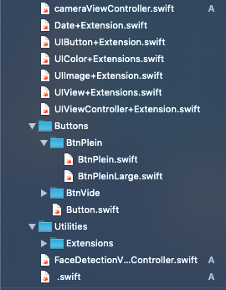
Front-End Progress
Swift in Xcode
AlamoFire Library for Web Service
Vision, VideoToolbox for Face Recognition
MessageUI for Sending Message to User

Slide 13
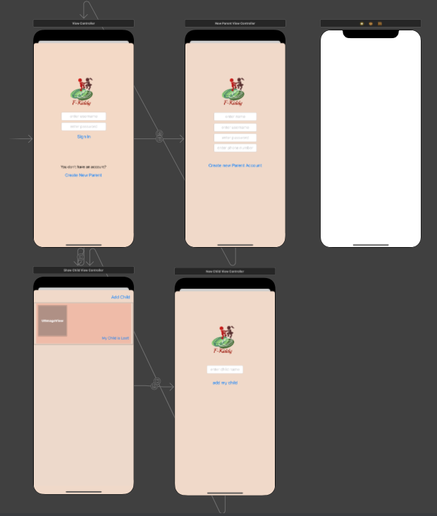

Slide 14
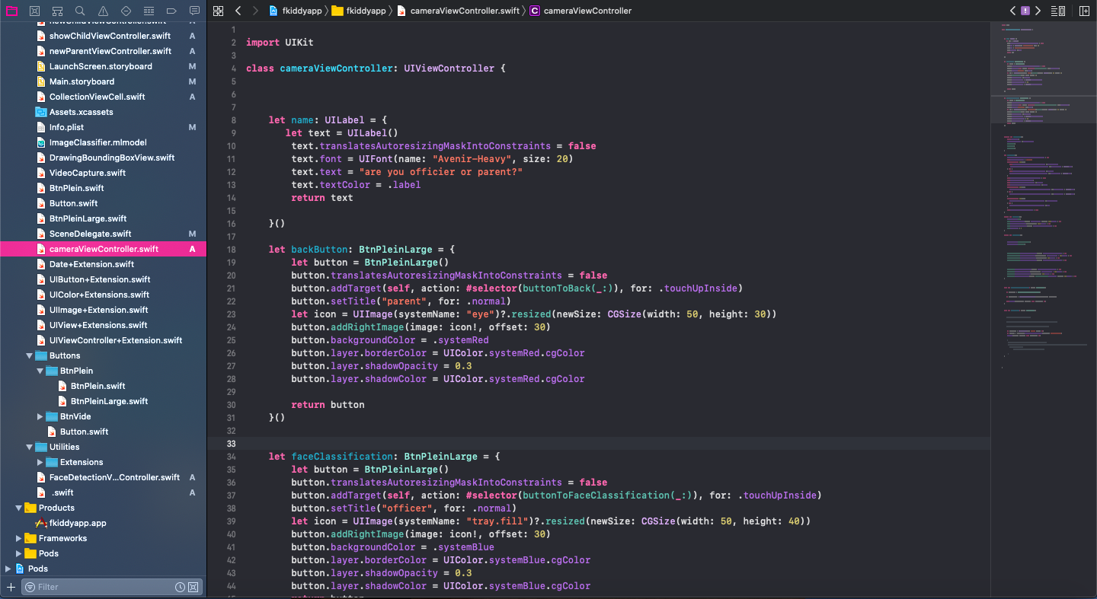
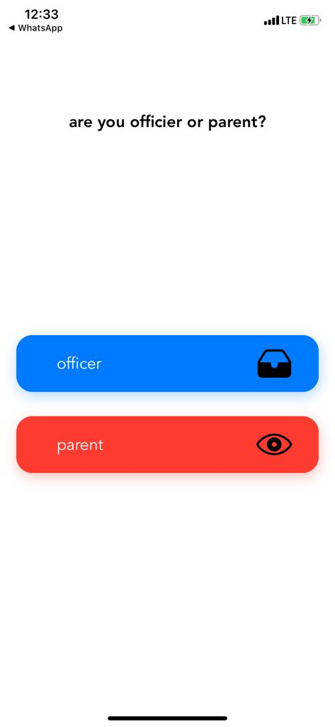

Slide 15
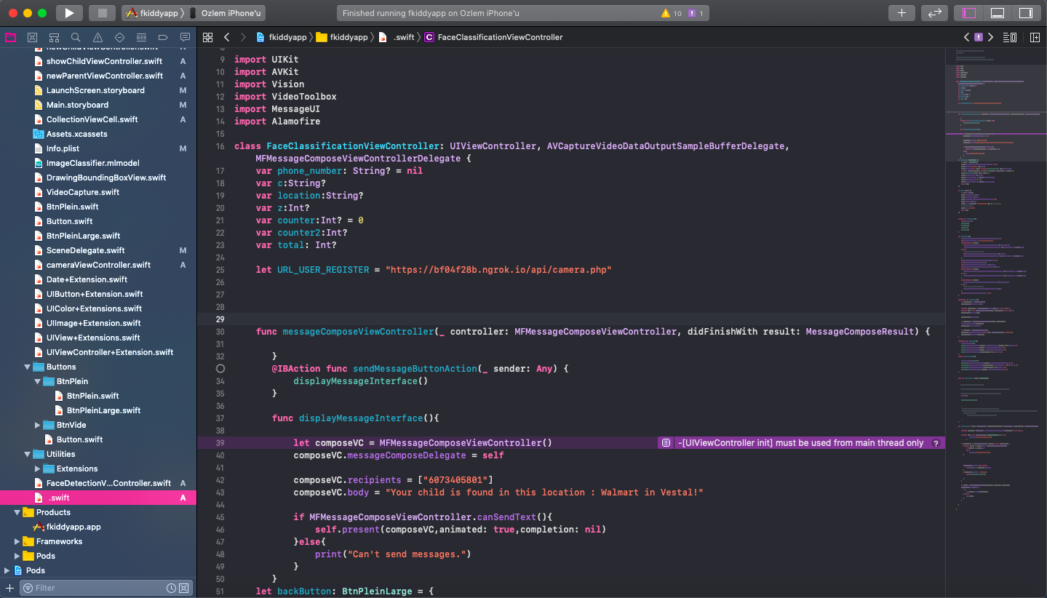
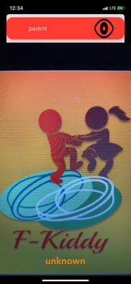
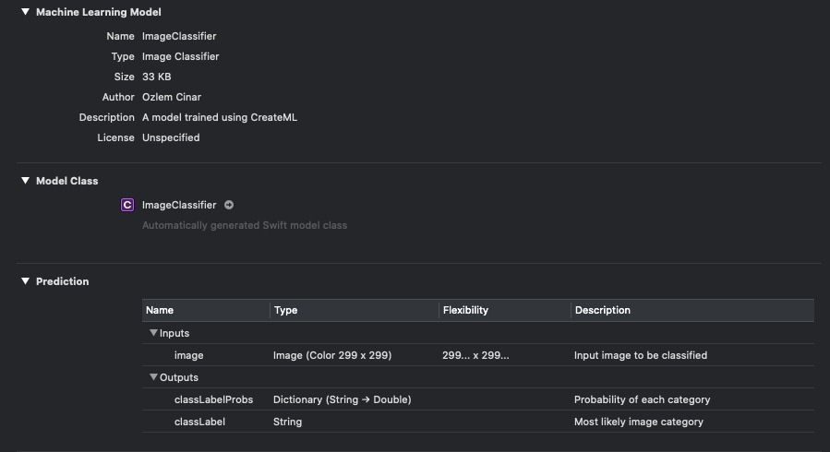

Slide 16
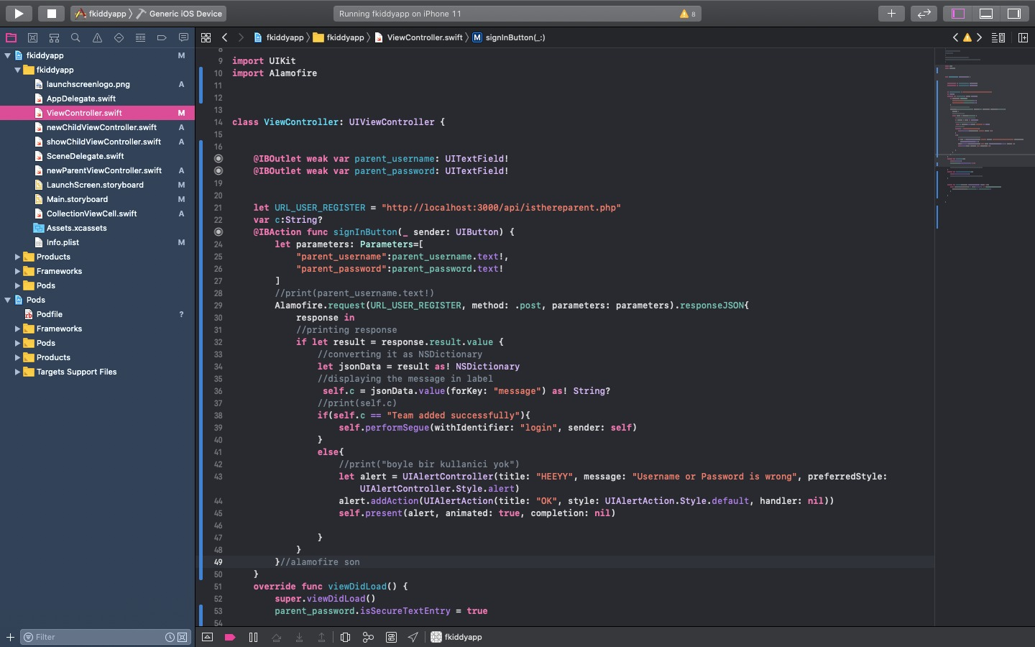
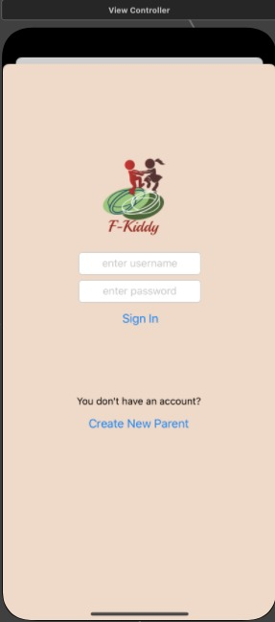

Slide 17
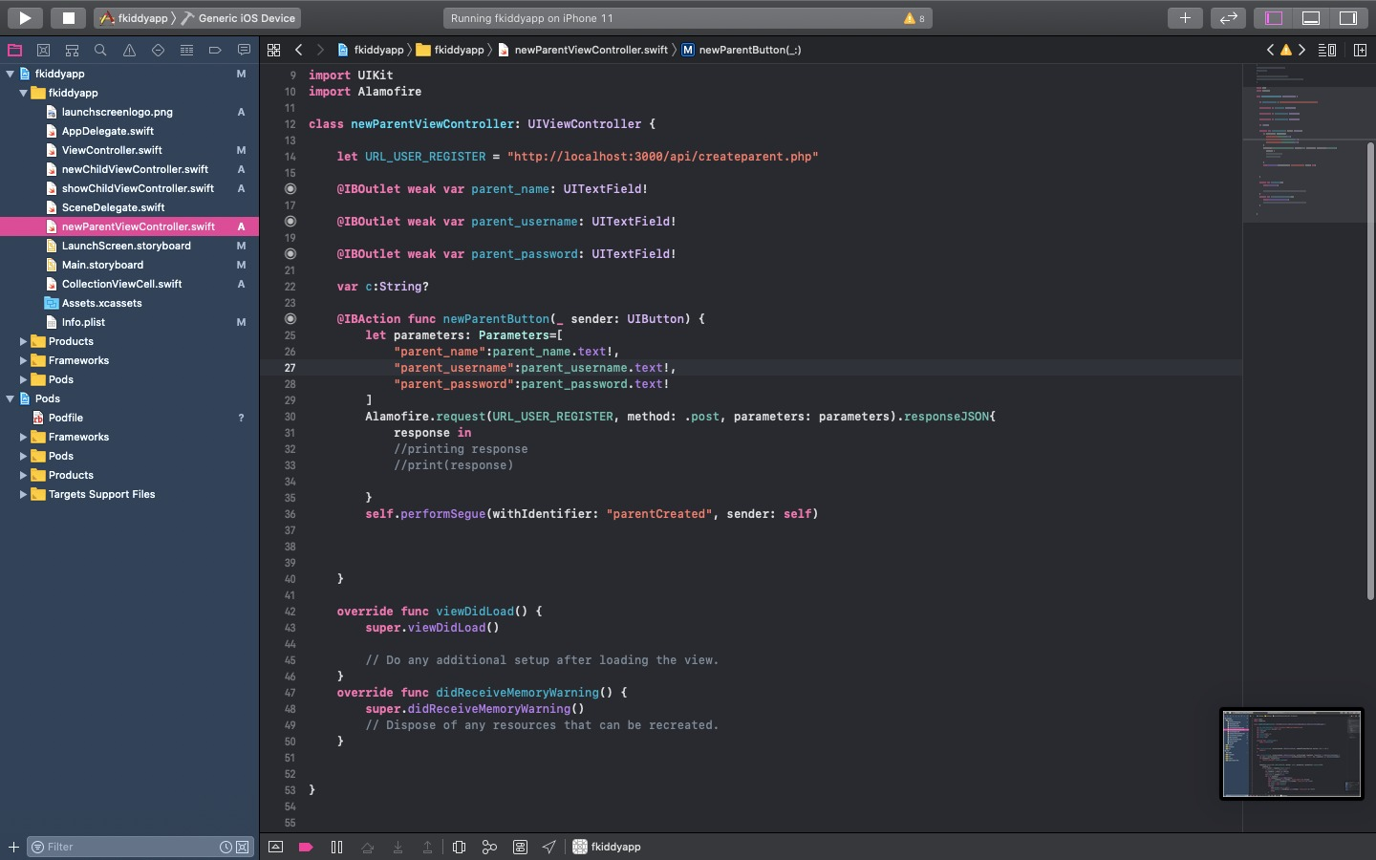
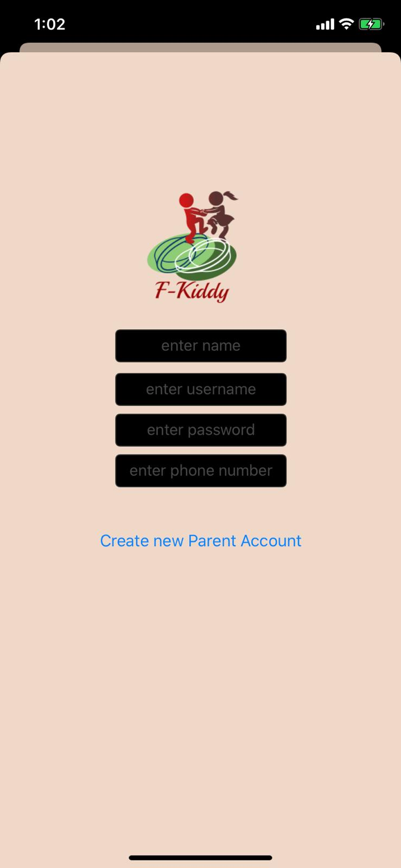

Slide 18
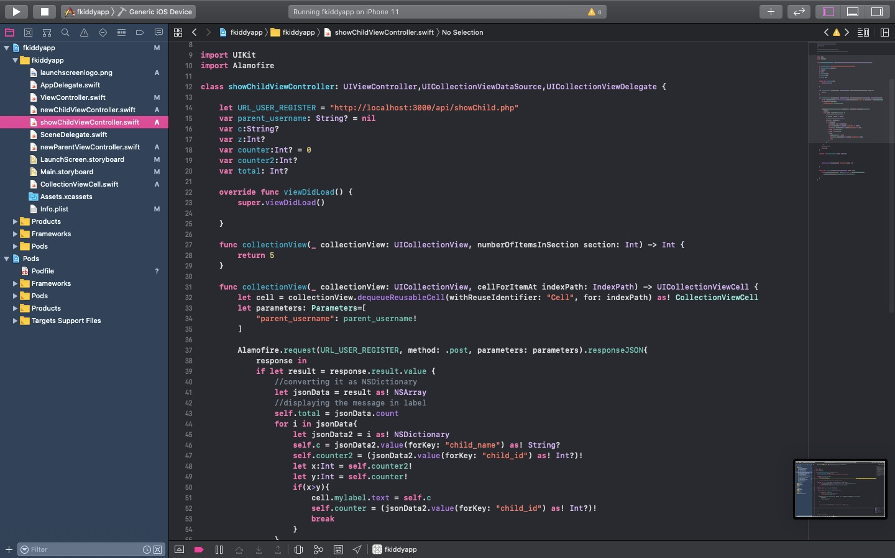
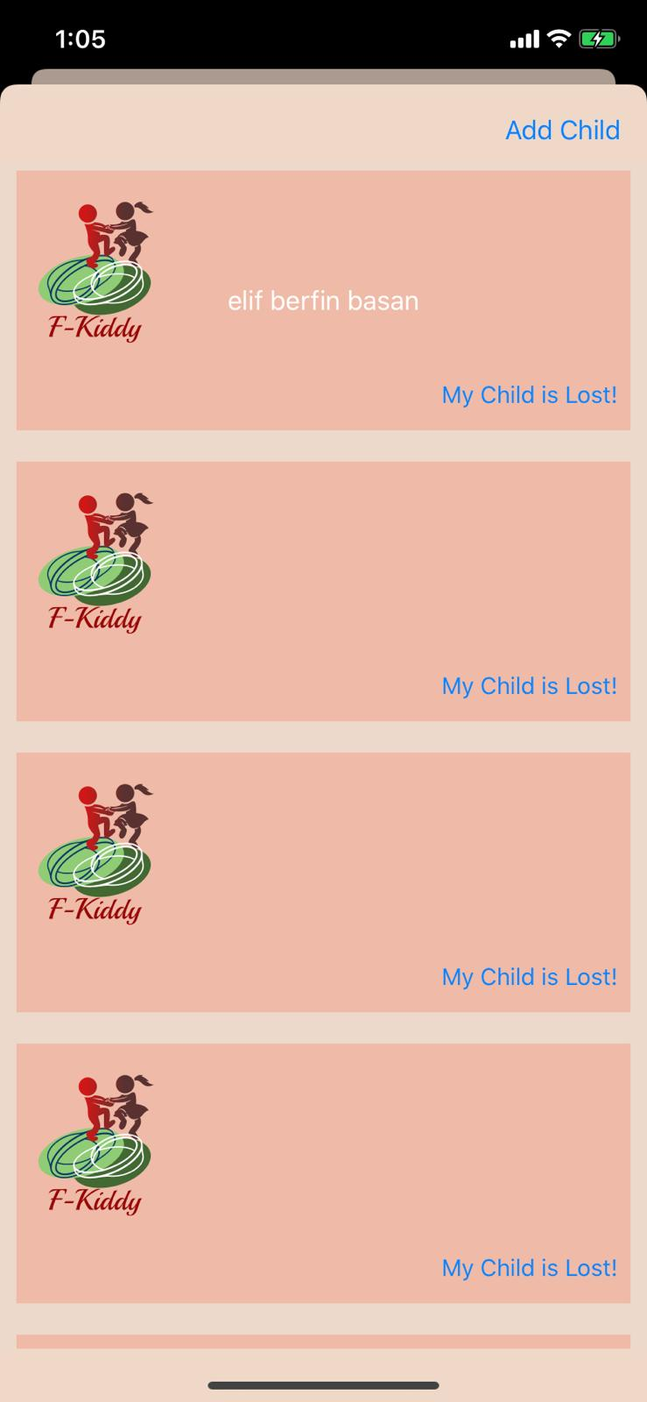

Slide 19
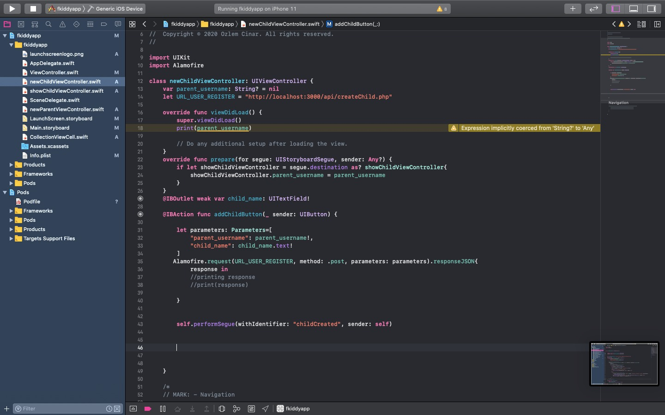
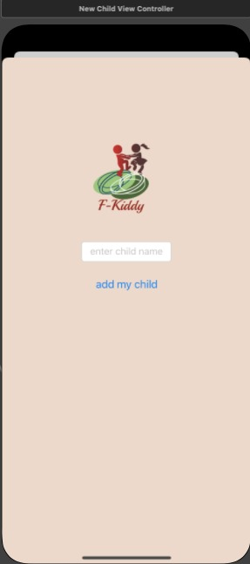

Slide 20


